Slide 1
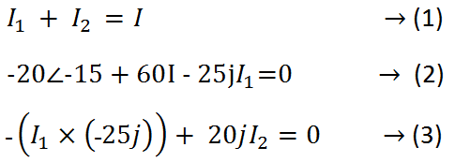
●solve these equations, find I₁, I₂ and I in polar form:

Slide 2
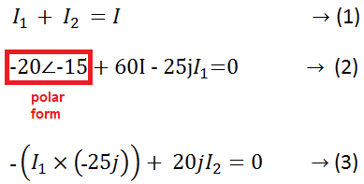
●solve these equations, find I₁, I₂ and I in polar form:

Slide 3
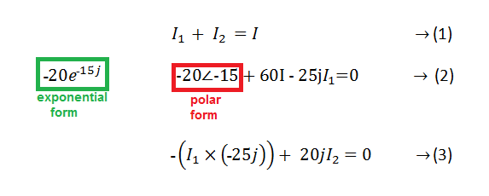
●solve these equations, find I₁, I₂ and I in polar form:

Slide 4
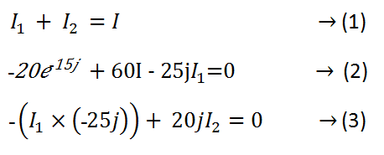
●solve these equations, find I₁, I₂ and I in polar form:

Slide 5
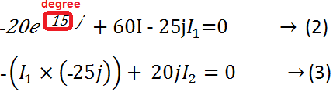
●solve these equations, find I₁, I₂ and I in polar form:

Slide 6
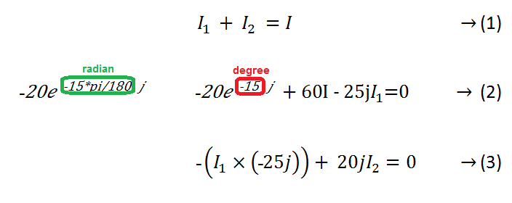
●solve these equations, find I₁, I₂ and I in polar form:

Slide 7
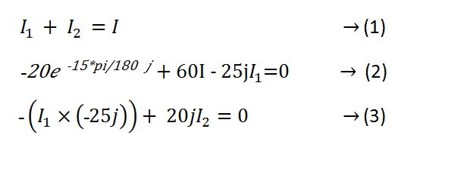
●solve these equations, find I₁, I₂ and I in polar form:

